Slide 1
READ ME This template uses the font ‘Space Grotesk’ – be sure to download the font before making edits to the deck. Here’s the link to the ZIP file containing the font. If you cannot access the link above, you can download the font for free via Google Fonts.

Slide 2
Deployment to Azure Kubernetes Service

Slide 3
Azure Kubernetes Service

Slide 4
Managed Kubernetes Cluster

Slide 5
Provisioning AKS instance via Azure CLI

Slide 6
Deploying apps via Aspirate

Slide 7
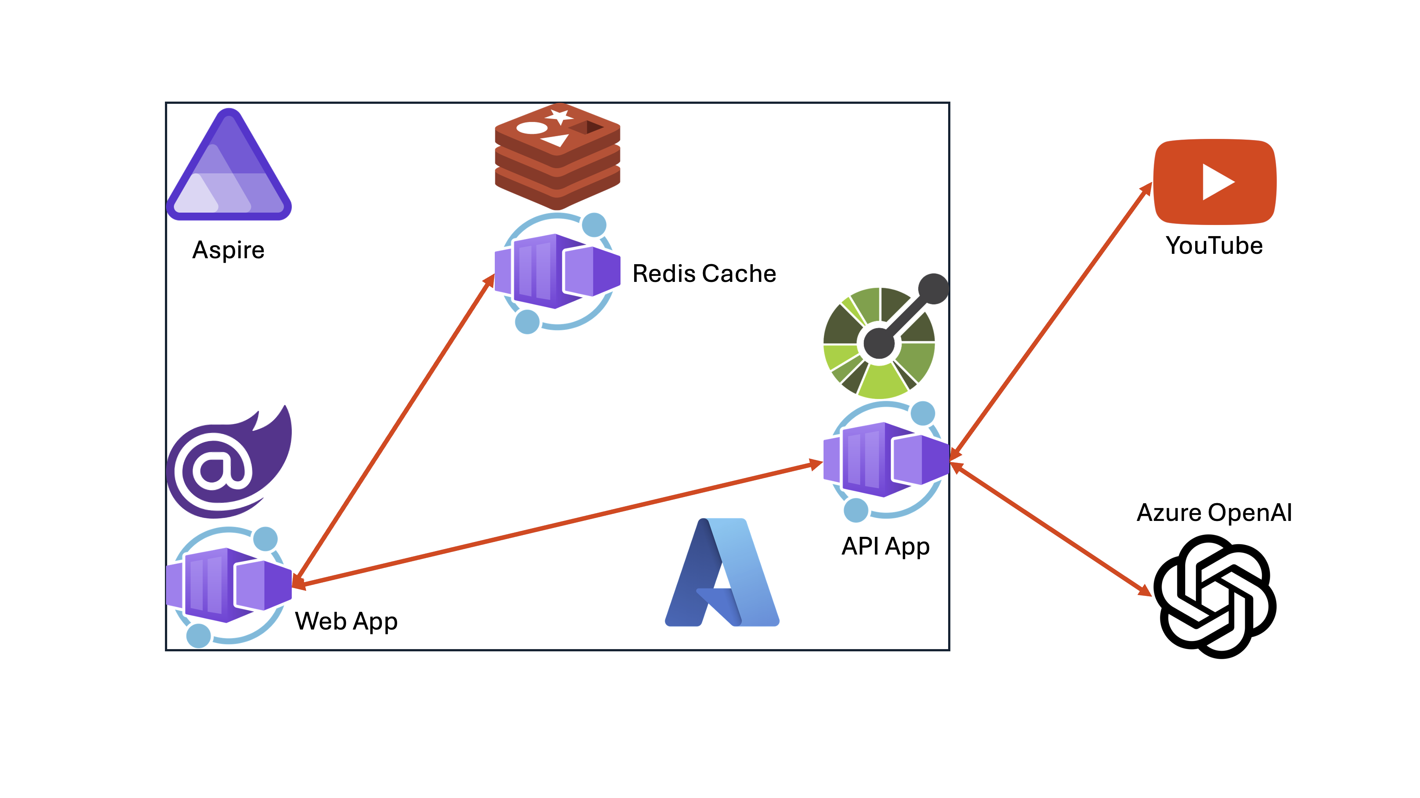

Slide 8
Let’s get started!
https://aka.ms/aspireinadaykr

